Slide 1

Team 01 Engineering Senior Design 2010-2011
Saturday, May 7, 2011

Slide 2
Outline
The Team
The Project
Design Norms
System Overview
Individual Subsystems
Design
Obstacles
Final Design
Project Assessment
Acknowledgments
Questions

Slide 3

The Team
Four electrical engineering students
Mixed software and hardware experience
Amy Kendrick Nathan Avery

Slide 4
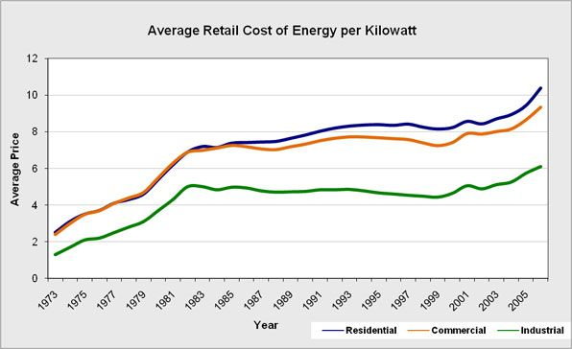
Project Selection
Notes:
Cost: http://www.project.org/info.php?recordID=247
USEIA: http://www.eecs.mit.edu/eecsenergy/

Slide 5
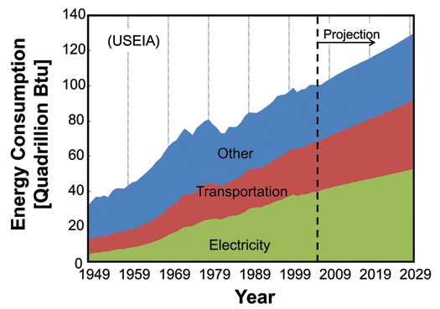
Project Selection
Price of energy is increasing.
Energy consumption is increasing.
Electric power metering
Provide useful data for more efficient consumption

Slide 6
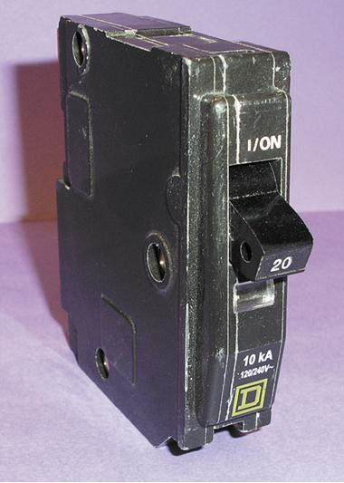
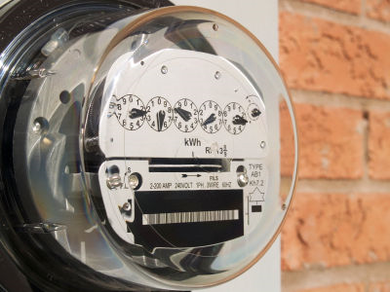
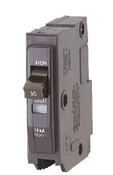
The Project
?
http://www.cpsc.gov/cpscpub/prerel/prhtml07/07036.jpg
http://sp.life123.com/bm.pix/electric-meter.s600x600.jpg

Slide 7
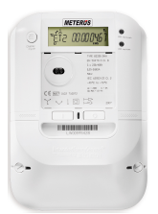
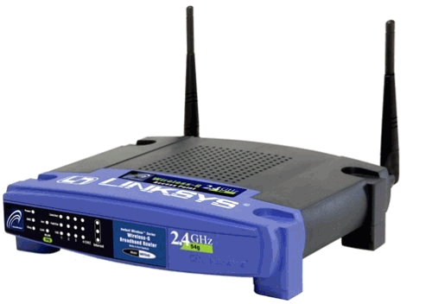
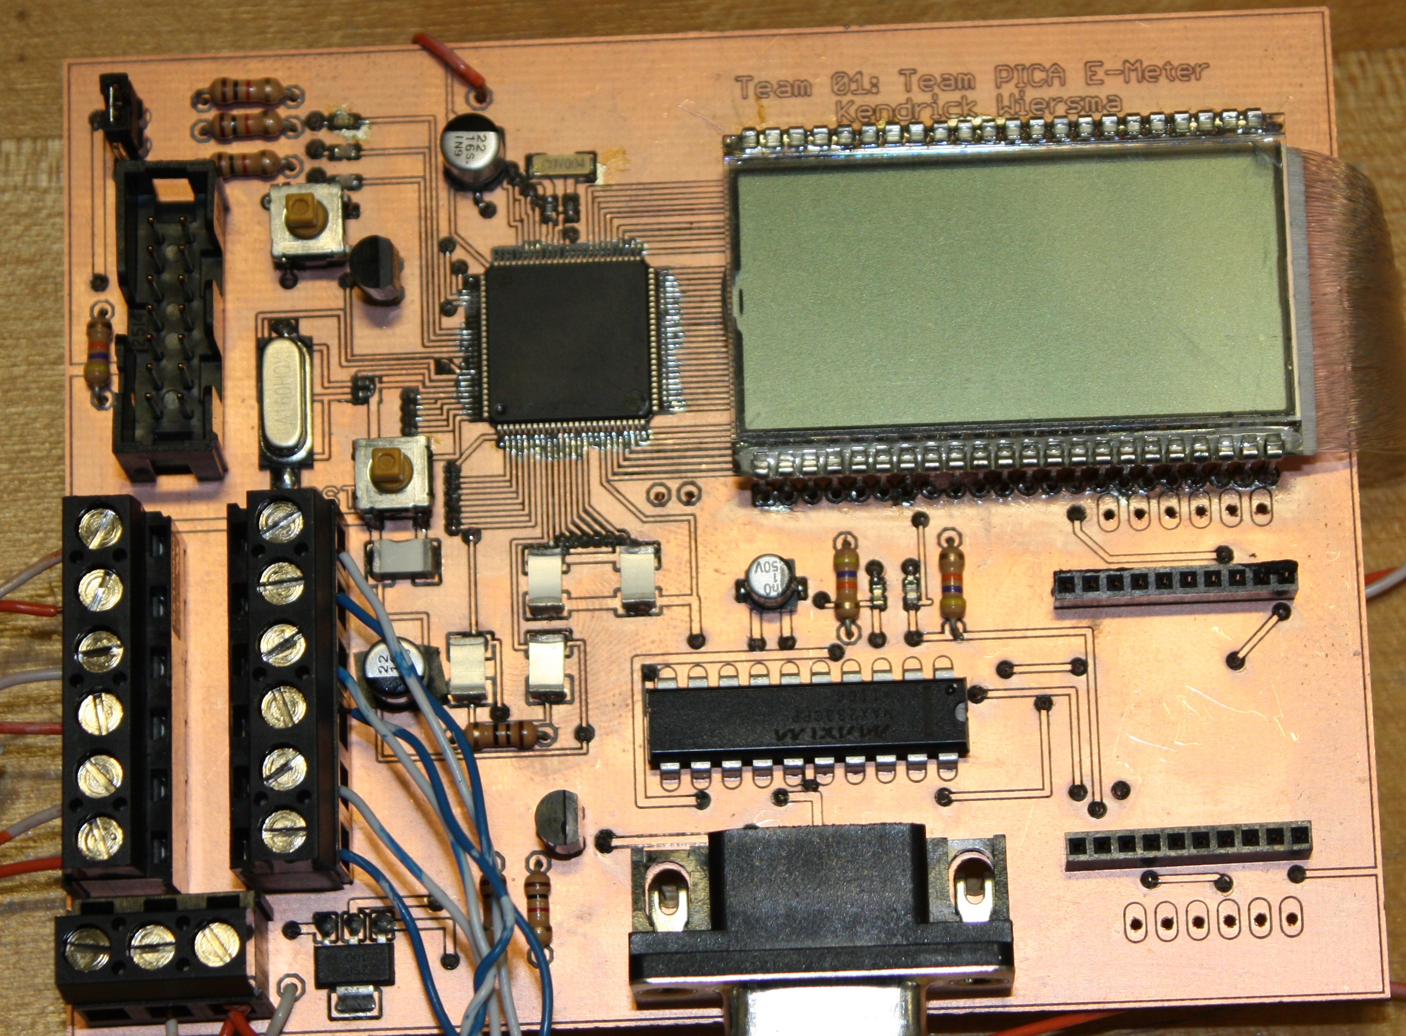
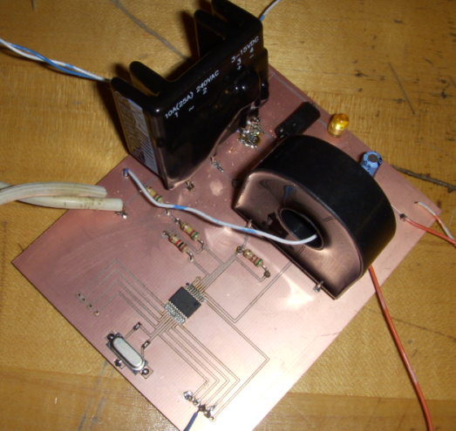

The Project
http://earlvillefreelibrary.org/images/computer_pic.jpg

Slide 8
Design Norms
Stewardship
By providing information regarding power consumption we enable consumers to make more conscious decisions about power consumption.
Transparency
The design must work as advertised and clearly alert the user to a fault.
Integrity
The design must accurately report power usage.

Slide 9
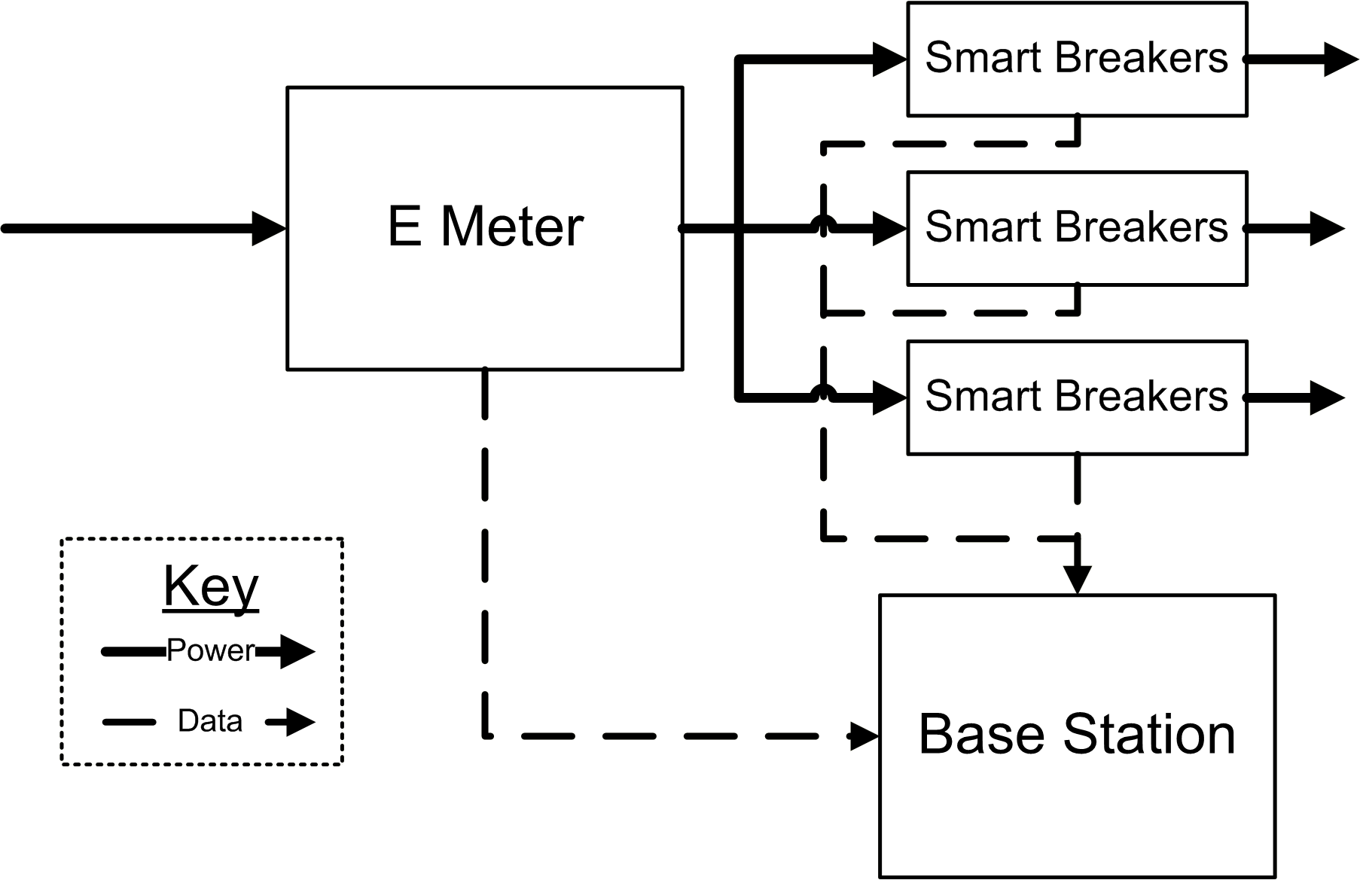
System Overview
E Meter
Measure all power
3 Phase
Smart Breakers
Measure individual circuits
Circuit interruption
Base Station
Presents information

Slide 10
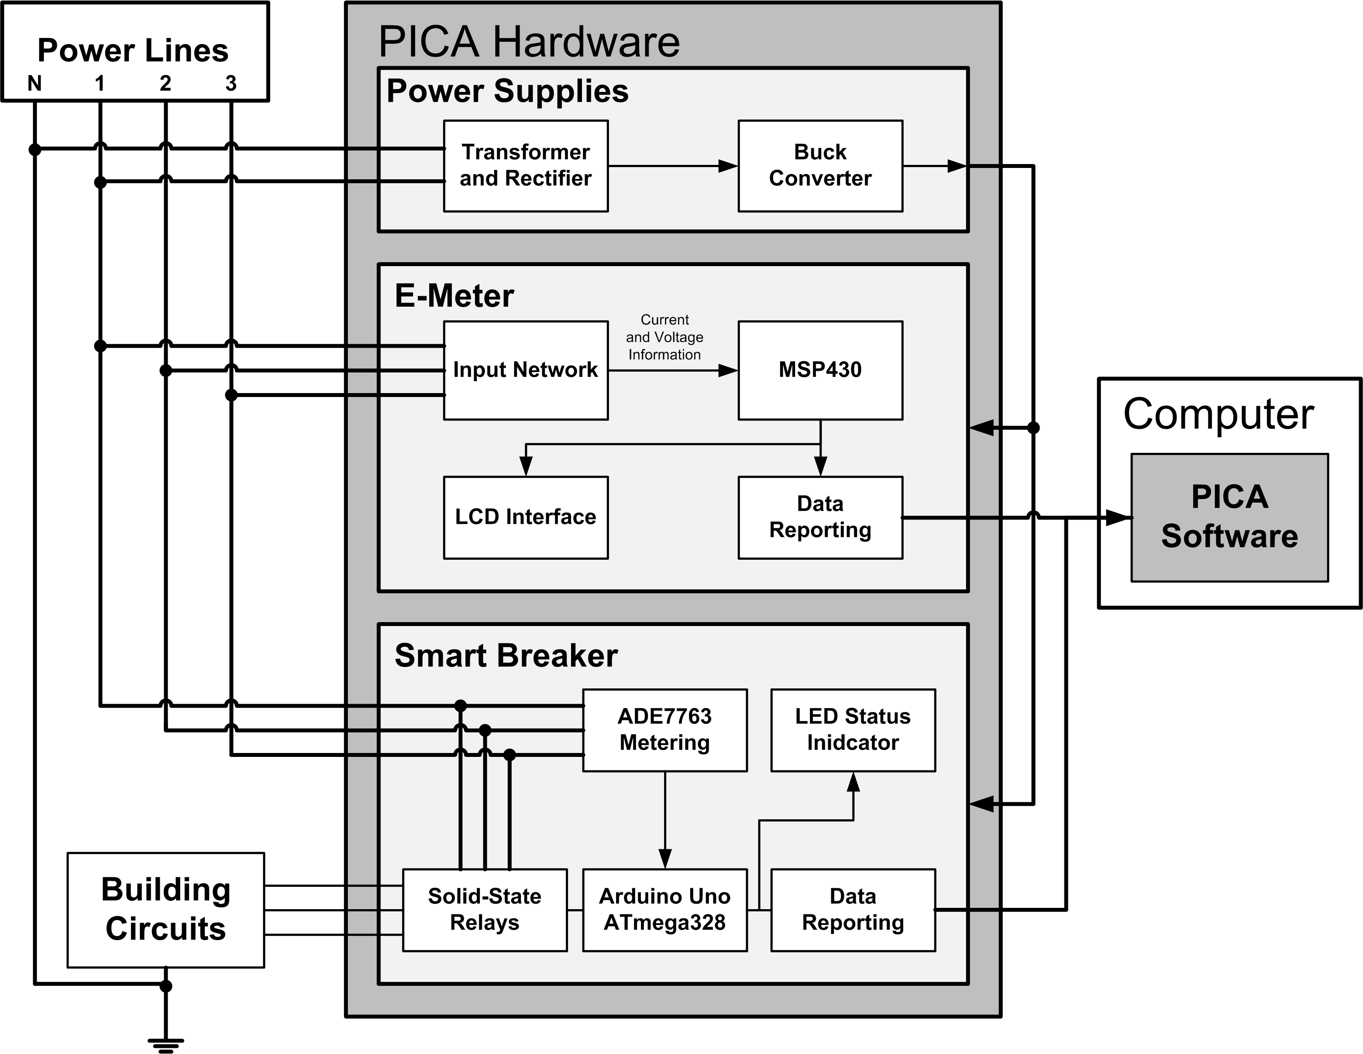
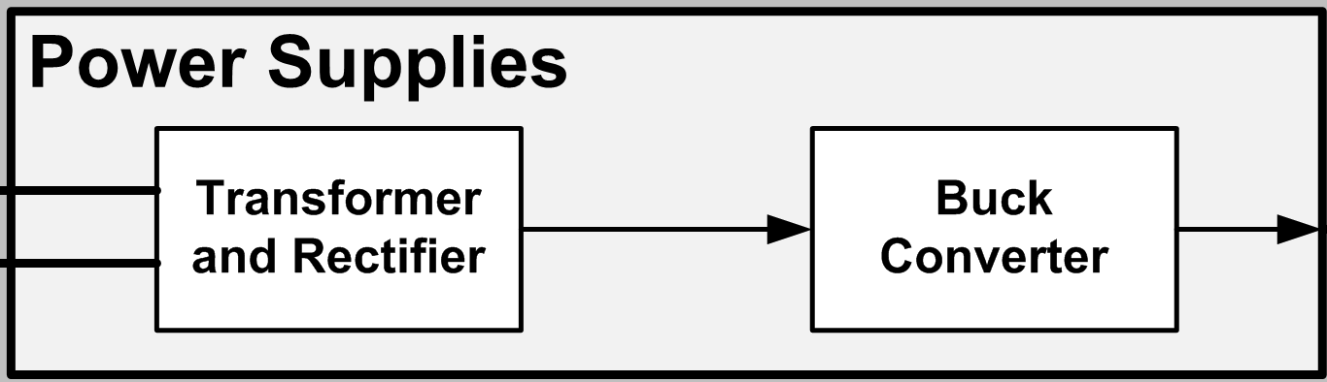
System Diagram

Slide 11
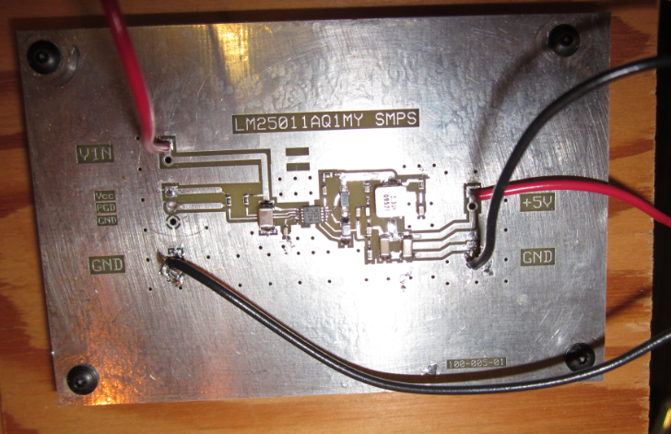
Power Supply
Technical Lead: Amy Ball

Slide 12
Power Supply: Design
What was needed?
Alternatives
Decision

Slide 13
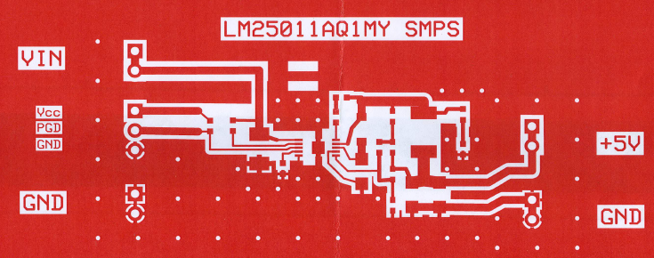
Power Supply: Layout

Slide 14
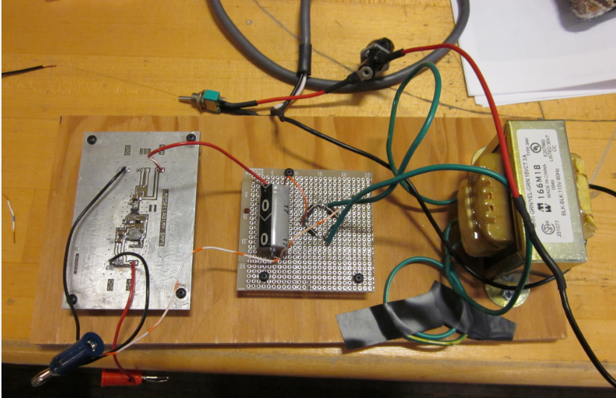
Power Supply: Final Assembly

Slide 15
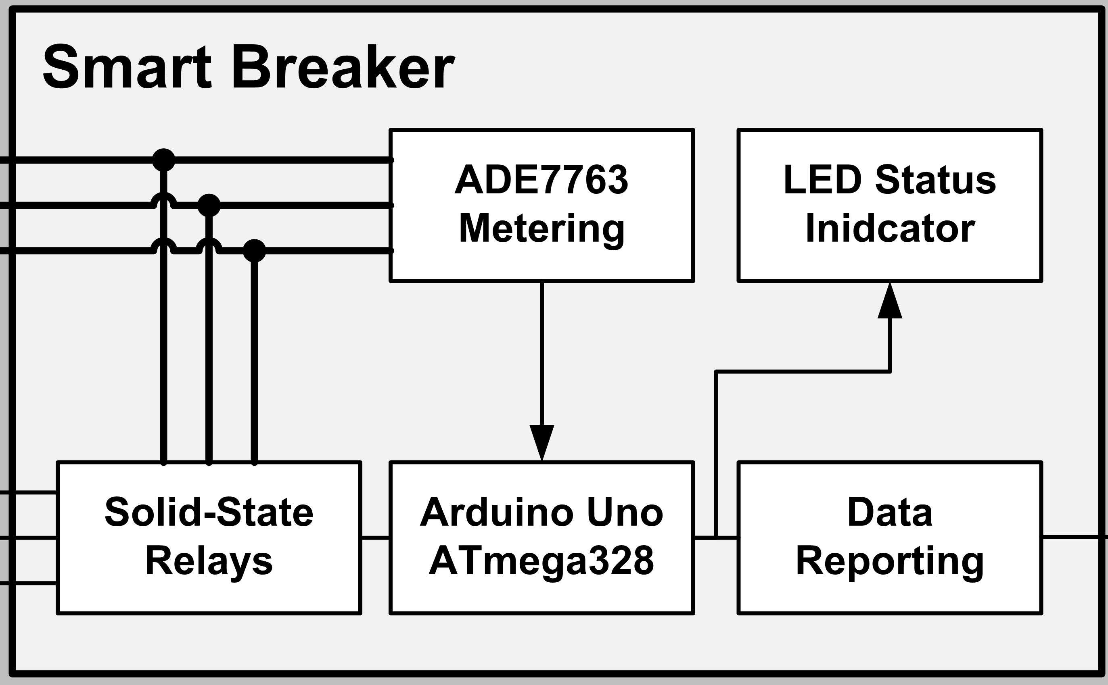
System Diagram

Slide 16
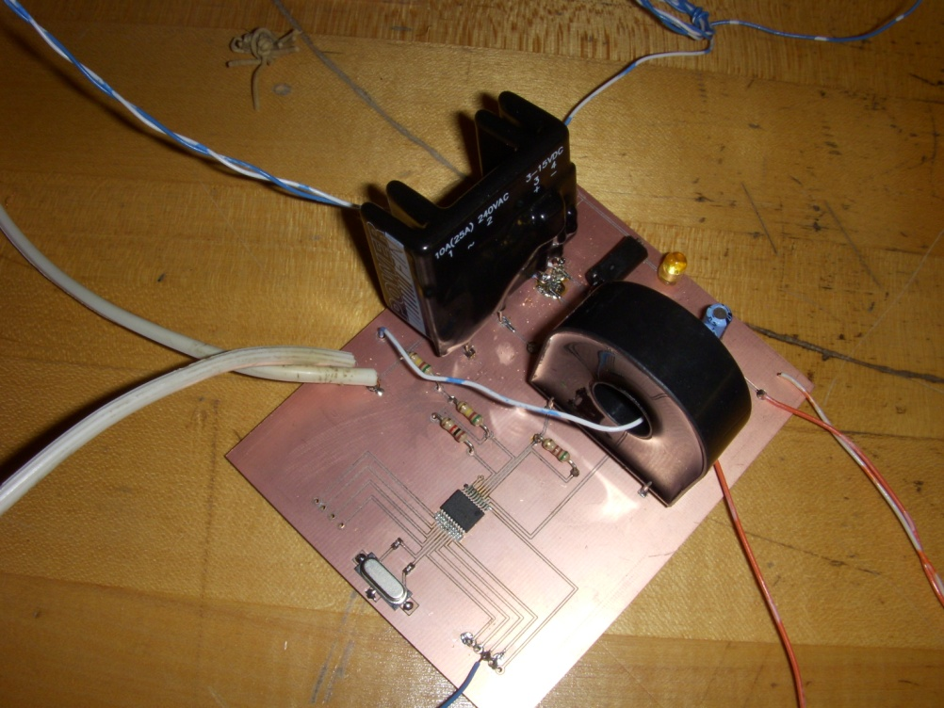
Smart Breakers
Technical Lead: Nathan Jen

Slide 17
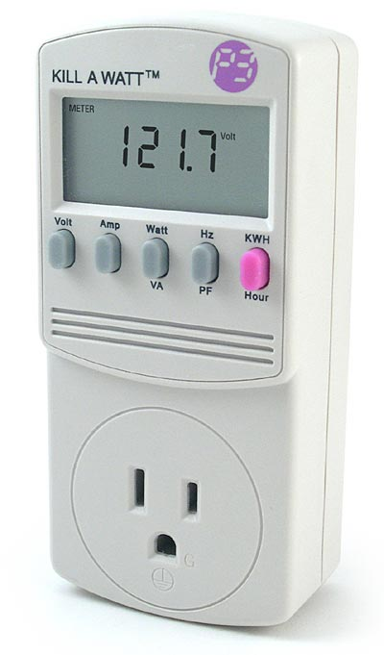
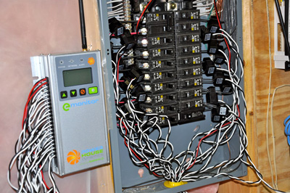
Smart Breakers
Provides the ‘map’ of where electricity is used
Conveniently located out of the way
Pictures:
http://www.home-energy-metering.com/home-energy-monitor.html
http://www.thinkgeek.com/images/products/zoom/kill_a_watt.jpg

Slide 18
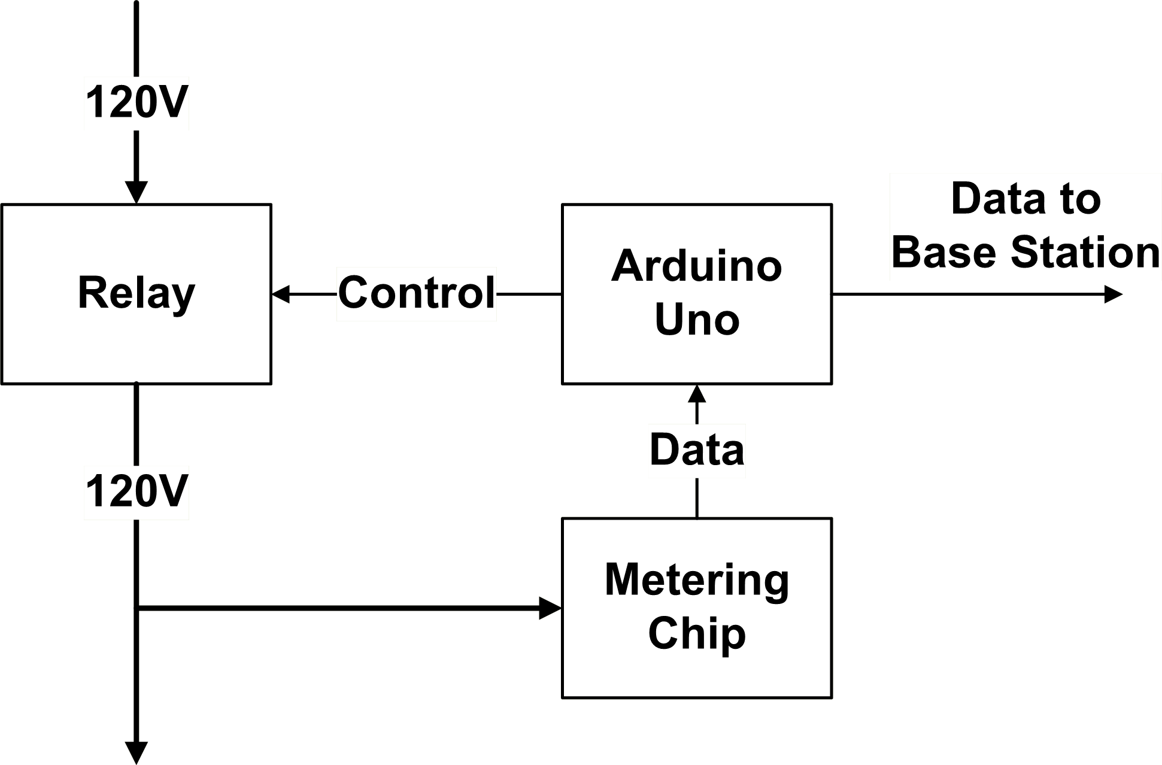
Smart Breakers: Block Diagram
Notes:
Needs cleaning, but need Visio or creative arrows & I’m too tired to be creative

Slide 19
Smart Breaker: Design Decisions
Proof of concept
Use ADE7763
NIOS II microcontroller
Solid state relay
Obstacle
Microcontroller documentation

Slide 20
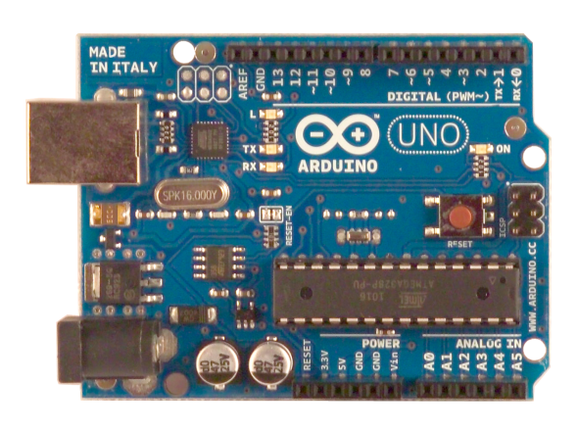
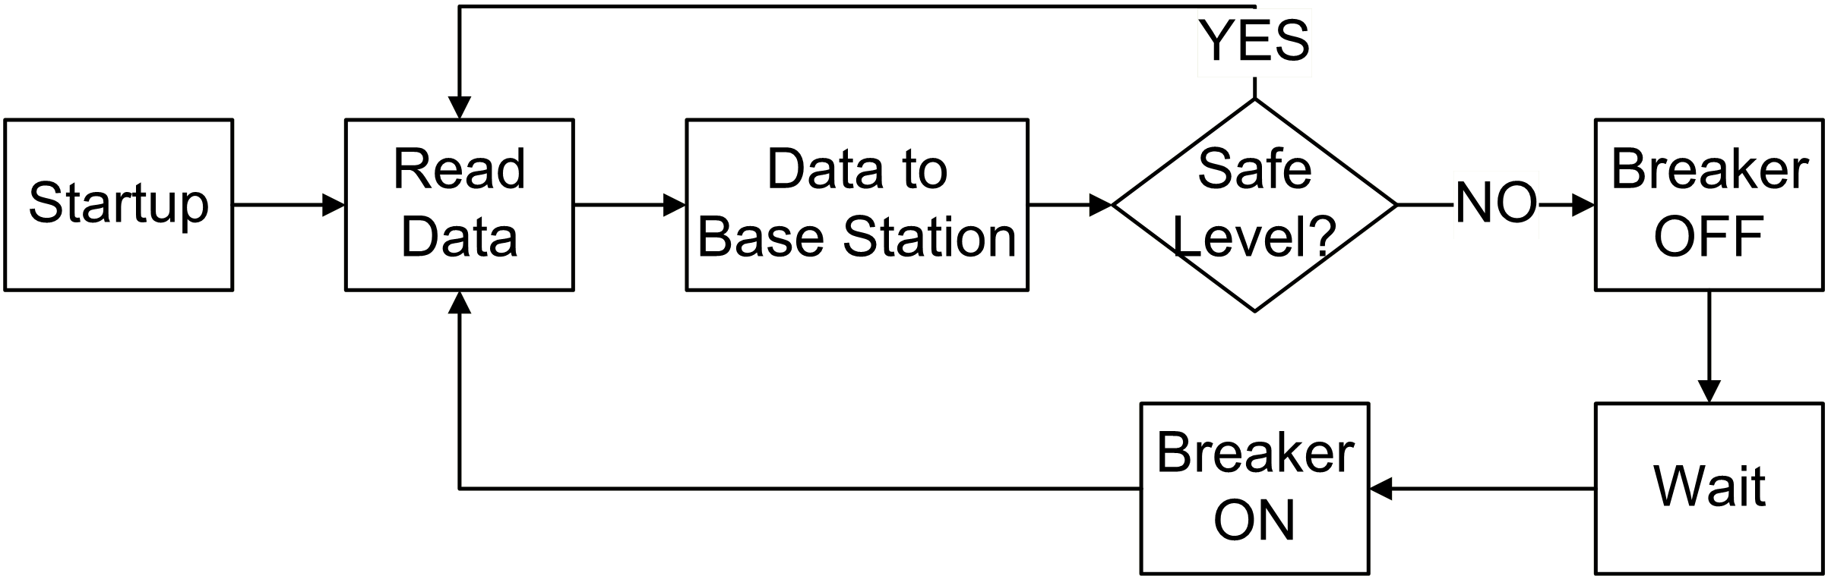
Smart Breakers: Software
Transfer data
Check for unsafe voltage & current
Arduino Uno picture: www.arduino.cc

Slide 21
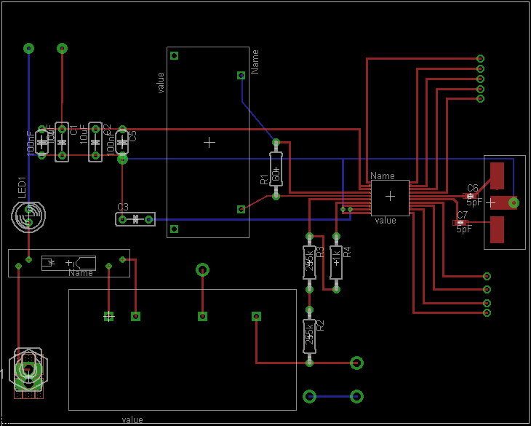
Smart Breakers: PCB
SPI Interface to Arduino
Emergency Switch
Interrupter
Metering
Device

Slide 22
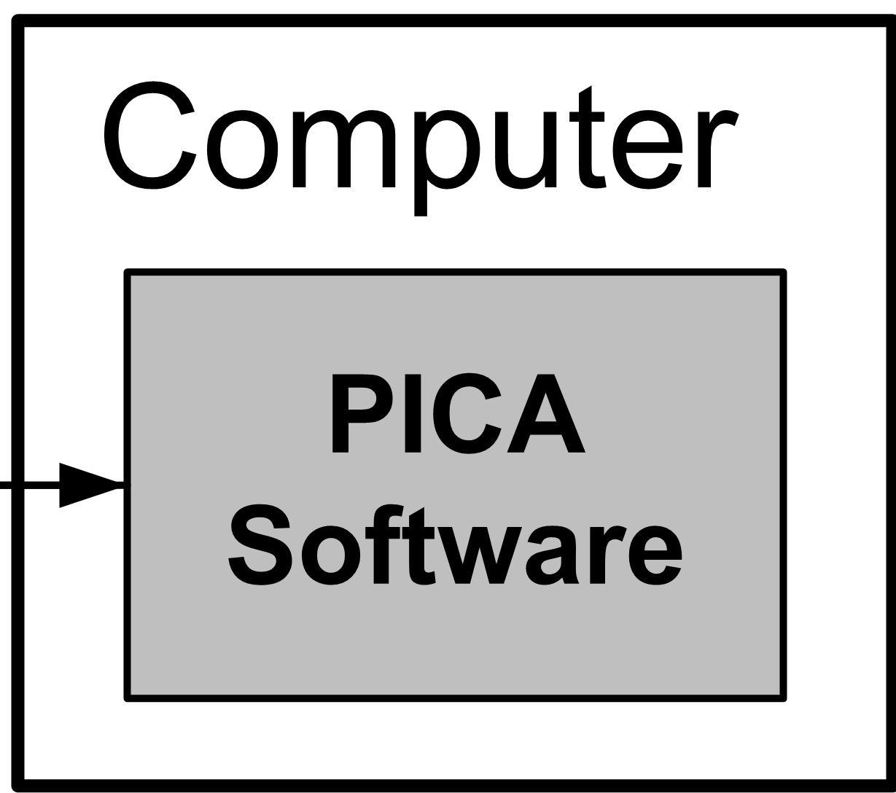
System Diagram

Slide 23
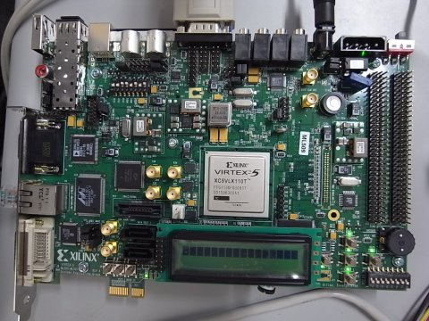
Base Station
Technical Lead: Avery Sterk

Slide 24
Base Station – Design Decisions
Needs to collect data from other subsystems
Best to have an always-on device
Needs to store data for future reference
Storage internal to the device
Needs to display information
Provide a familiar webpage-like interface
Best option: a single-purpose computer
Calvin already owned a suitable board

Slide 25
Base Station – Obstacles
Obstacles
Resolution
Processor selection
Operating System
Linux distribution severely disorganized and broken
Bootloader doesn’t work well with our Linux
LEON3 softprocessor (SPARC compatible)
Bundled Linux distribution
Built a custom Linux distribution from scratch
Change in scope: focus on collection software

Slide 26

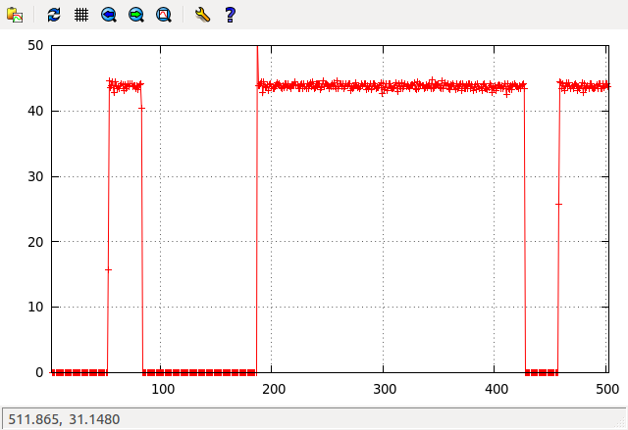
Base Station – Final Design
Perl script to manage a ZigBee network
Use Perl and Gnuplot to chart data
Camel Logo by O’Reilly Media, from www.perl.com

Slide 27
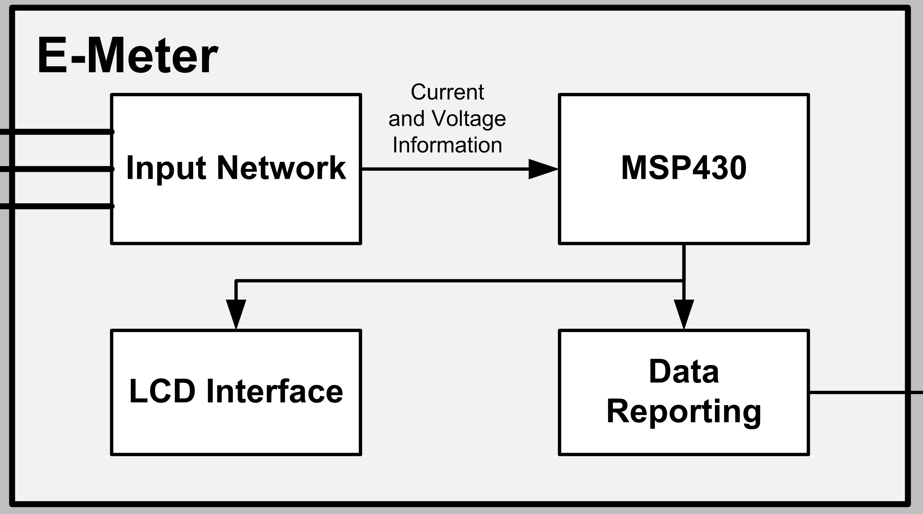
System Diagram

Slide 28
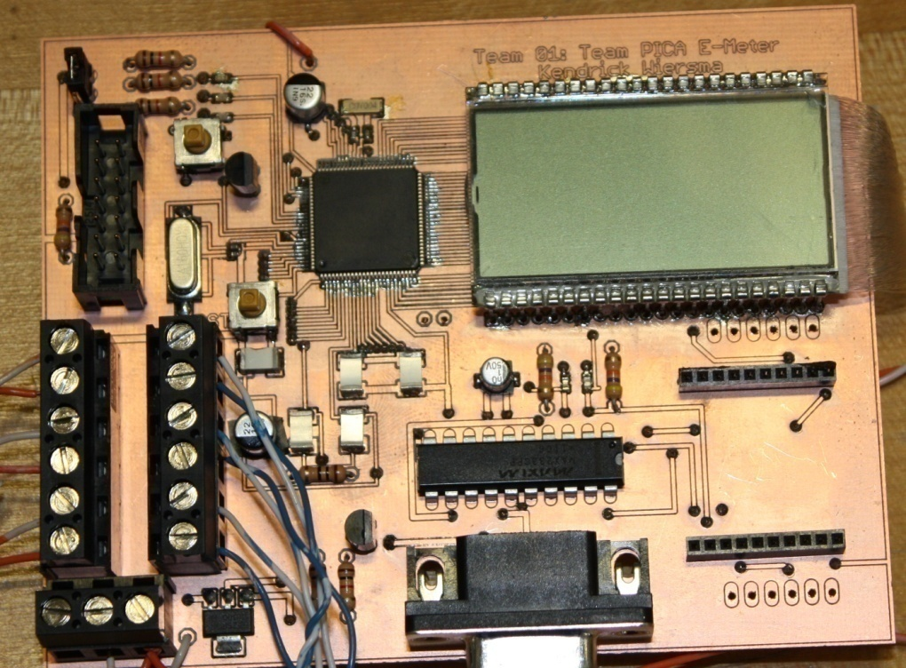
E-Meter Hardware
Techincal Lead: Kendrick Wiersma

Slide 29
E-Meter Hardware: Design
MCU: MSP430 from Texas Instruments
Low power consumption
Tailored for metering applications
Integrated LCD driver
Serial Communications (RS232)
Xbee Radio
Dedicated printed circuit board

Slide 30
E-Meter Hardware: Obstacles
Obstacles
Resolution
Surface-mount components
Peripheral clocking
LCD driver
Board size limitation
JCI etched and populated board
Attach required crystals
Help from Chuck Cox of SynchroSystems in Boston.
Split board into two separate boards

Slide 31
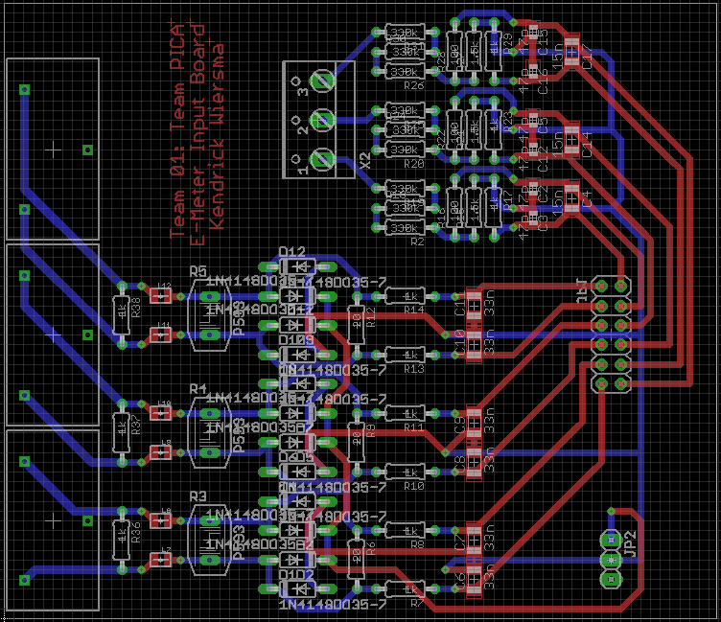
E-Meter Hardware: Input Board
Voltage Input
Current Transformers
Connection to main board

Slide 32
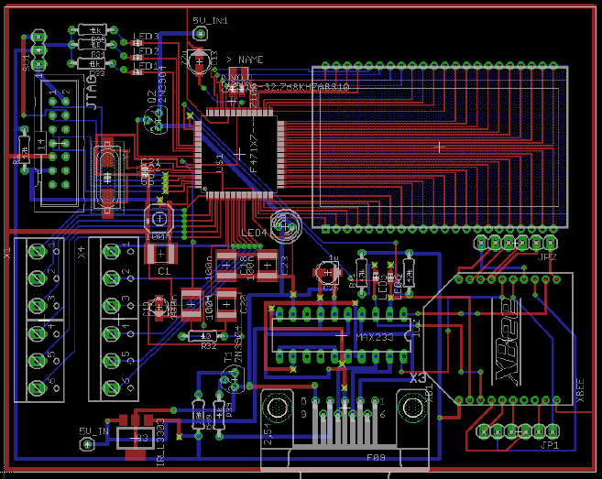
E-Meter Hardware: Main Board
MSP430 (MCU)
LCD Screen
Connection to Input board
Wireless Communication
Serial (RS232) Connection

Slide 33
E-Meter Software
Technical Lead: Avery Sterk

Slide 34
E-Meter Software: Design
Read current and voltage information
MSP430 reads analog information in hardware
Compute power and energy usage
Interpret data and crunch numbers
Run for a long time without resetting
Avoid overflowing data
Need to conserve power
Put features to sleep when not in use

Slide 35
E-Meter Software: Obstacles
Obstacles
Resolution
Interrupt-driven programming
Measurement calibration
LCD driver software was built for a different setup
Only one button for user interface
Study example code and part user manuals
Pre-compute conversion factors, verify results
Re-configure software, make HW substitutions
Create a simple interface, allow for more data sent to the base station

Slide 36
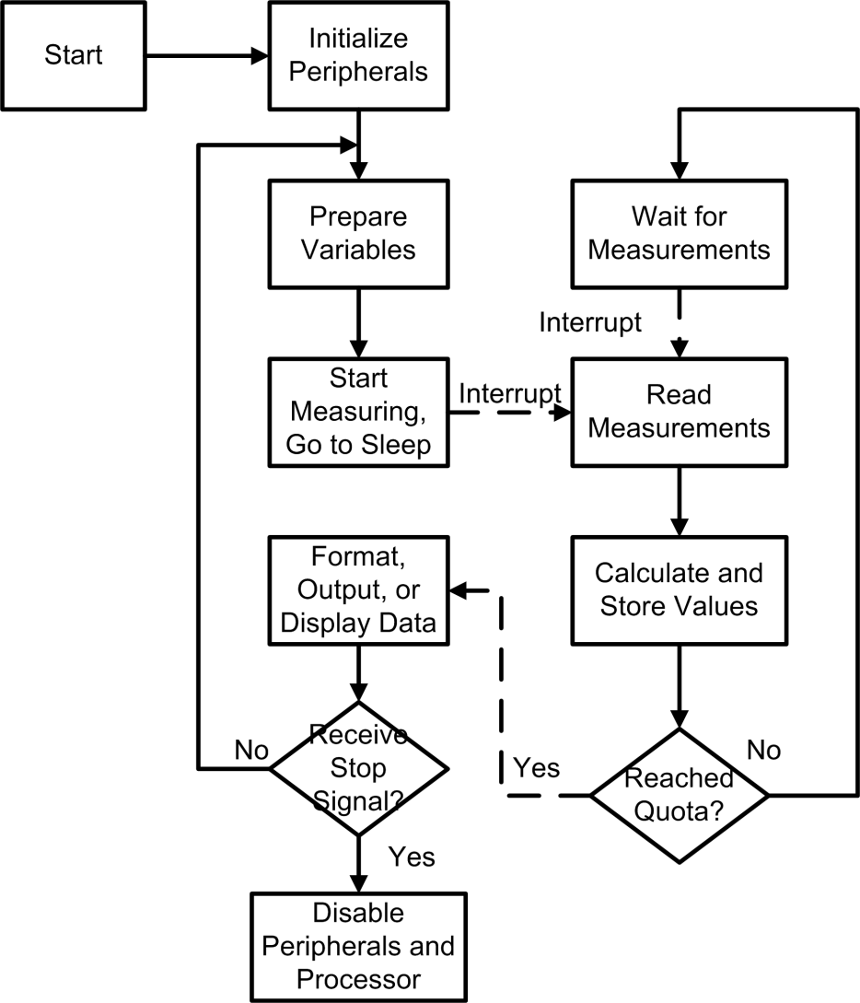
E-Meter Software: Final Design

Slide 37
Project Assessment
Project is a success
Met our goal of measuring power
Under budget: used $360 of $700 allowance
Learning Experience
Much more than equations and schematics
Experience with new EE concepts
Troubleshooting and recovery
What we would do differently
Limit scope to improve functionality

Slide 38
Acknowledgements
Professor VanderLeest – team advisor
JCI: Mark Michmerhuizen, Brian Deblay, Joshua Sliter
Tim Theriault – industrial consultant
Professor Ribeiro – Engr. 315 Controls class
Bob DeKraker, Chuck Holwerda, Phil Jasperse, Glenn Remelts
Professor Medema & Bus. 396 team
SynchroSystems – Chuck Cox, John Lupien
Consumer’s Energy
Texas Instruments
Thank You!

Slide 39
Questions
? ? ? ?

